Slide 1


LEAD SCORING CASE STUDY
BY:
SHIVANG NAIK AISHWARYA GYANJYOTI

Slide 2


PROBLEM STATEMENT
Building a logistic regression model for X education by assigning a lead score between 0 and 100 for targeting particular leads to be converted or not. Leads as in finally enrolling for a course by giving contact details like phone number and email address.
The CEO has given a ballpark of the target lead conversion rate to be around 80%.
Adjusting the company's requirement for further changes in the future.

Slide 3


APPROACH

Slide 4

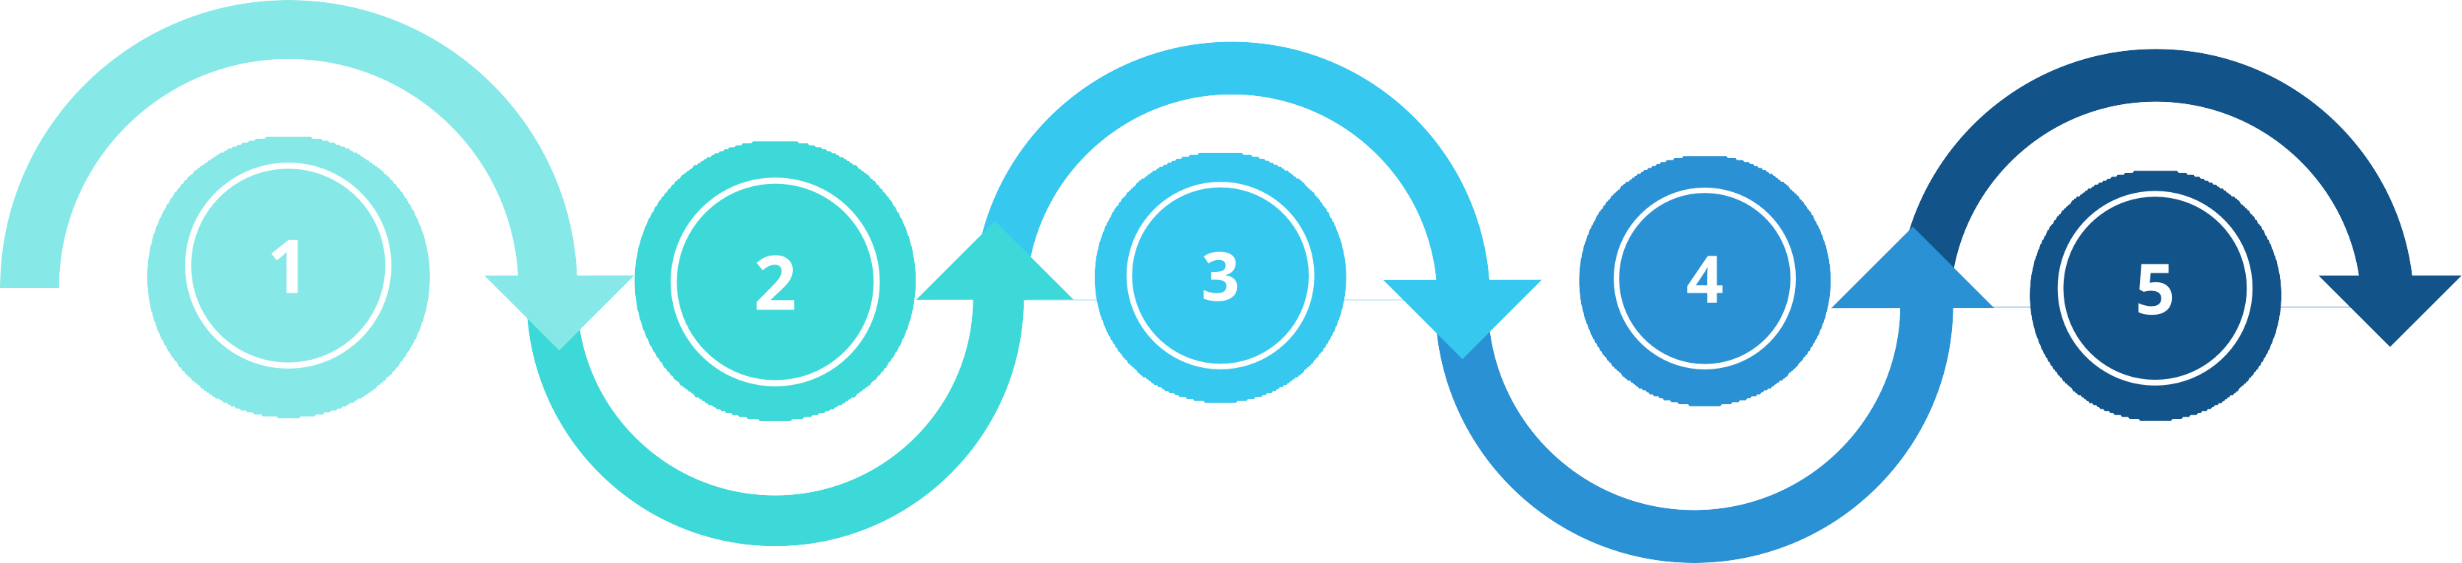

Exploratory data analysis and Data Preparation
Matrix Score test
Finding confusion matrix, Accuracy along with sensitivity and specificity.
Plotting ROC curve and finding optimal cut-off along with precision recall curve.
By creating dummy variables, Train-test split, Scaling of data and RFE
Data Inspection and Cleaning
Building a logistic regression model
Prediction on Test Data
The final prediction of test data conveying evaluation on the basis of model accuracy, sensitivity and specificity
Checking the information, numerical description, null values of the dataset, and removing unwanted columns.
Features to be eliminated one by one having high P- values and VIF.

Slide 5


DATA VISUALIZATION

Slide 6
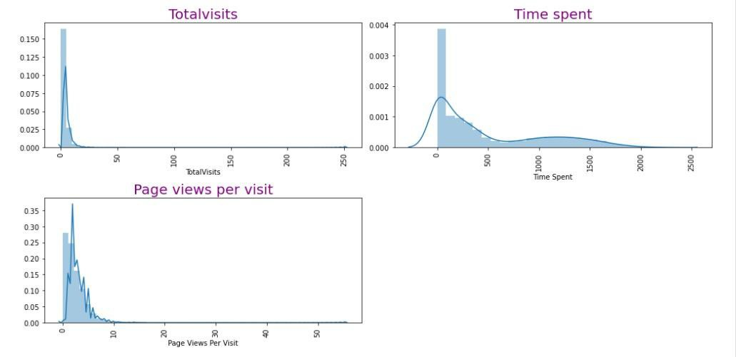

UNIVARIATE ANALYSIS
Normal distribution of the above variables.

Slide 7
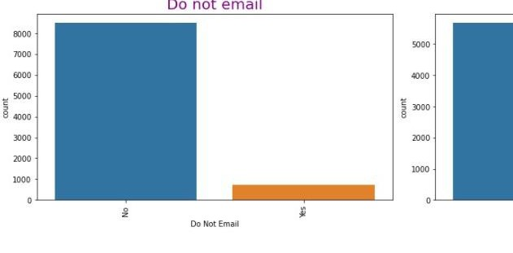

Landing seems to
page submission have the majority
among other origins of the lead.
5000+ leads aren't converted yet i.e., they won't enroll in the course.
Seems like the customer doesn't opt for receiving emails related to the course after looking at "Don Not Email".

Slide 8
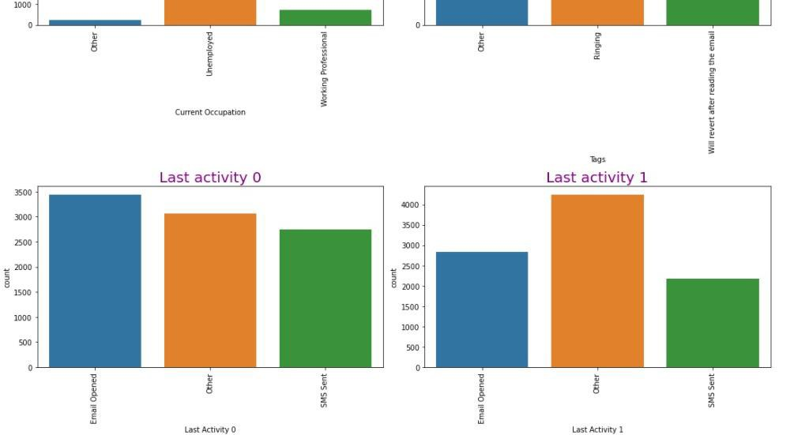

8000+ customers with current occupation as "unemployed" are interested in this course.
As per the current status in"Tags", most of them will revert after receiving the mail

Slide 9
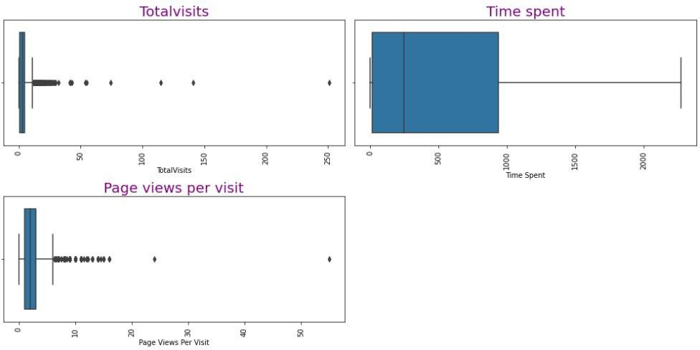
CHECKING OUTLIERS
Visibility of outliers in Total Visits and Page Views per visit.

Slide 10
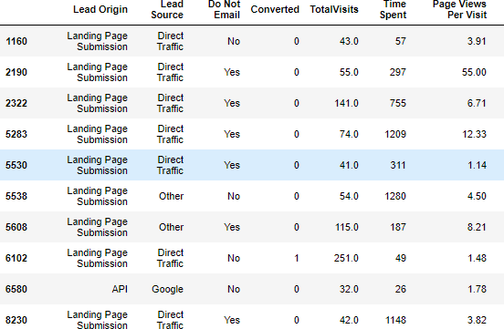
If Total Visits are more than 30 then most of times they are not converted.It doesn't look convenient that person visiting site for so many times.
For that , outlier treatment is done by removing it.

Slide 11
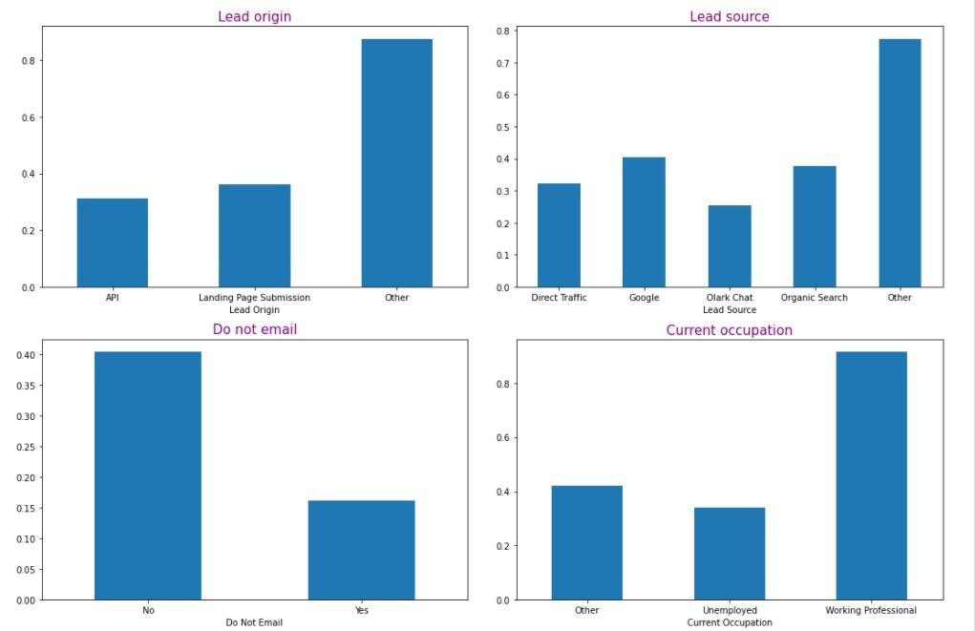

BIVARIATE ANALYSIS

Slide 12
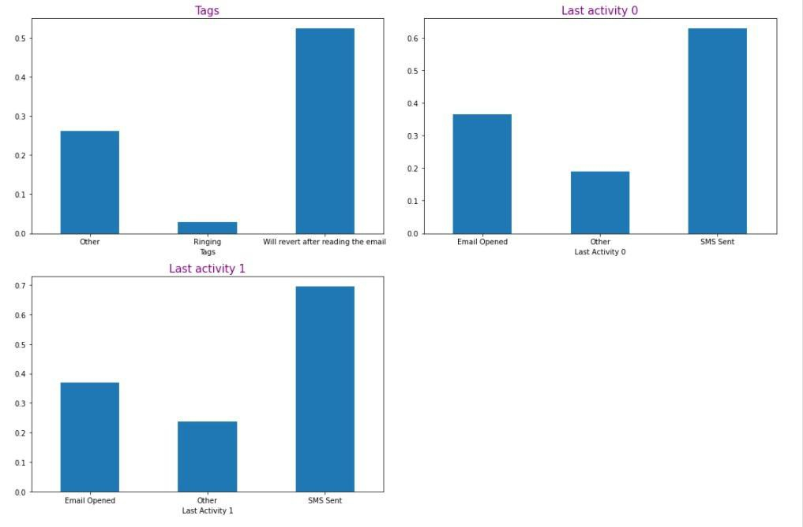

Slide 13


"Converted" has been used as the target variable. It tells whether a past lead was converted or not wherein 1 means it was converted and 0 means it wasn’t converted.
In Last Activity 0 & 1, `SMS Sent` has a good Converted ratio.
`Working Proffesional` has more interest towards course.

Slide 14

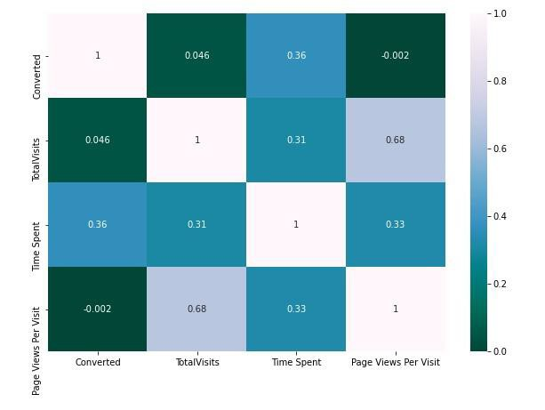

CORRELATION BETWEEN THE VARIABLES
Total Visits and Page Views Per Visit are positive correlates with each other.

Slide 15
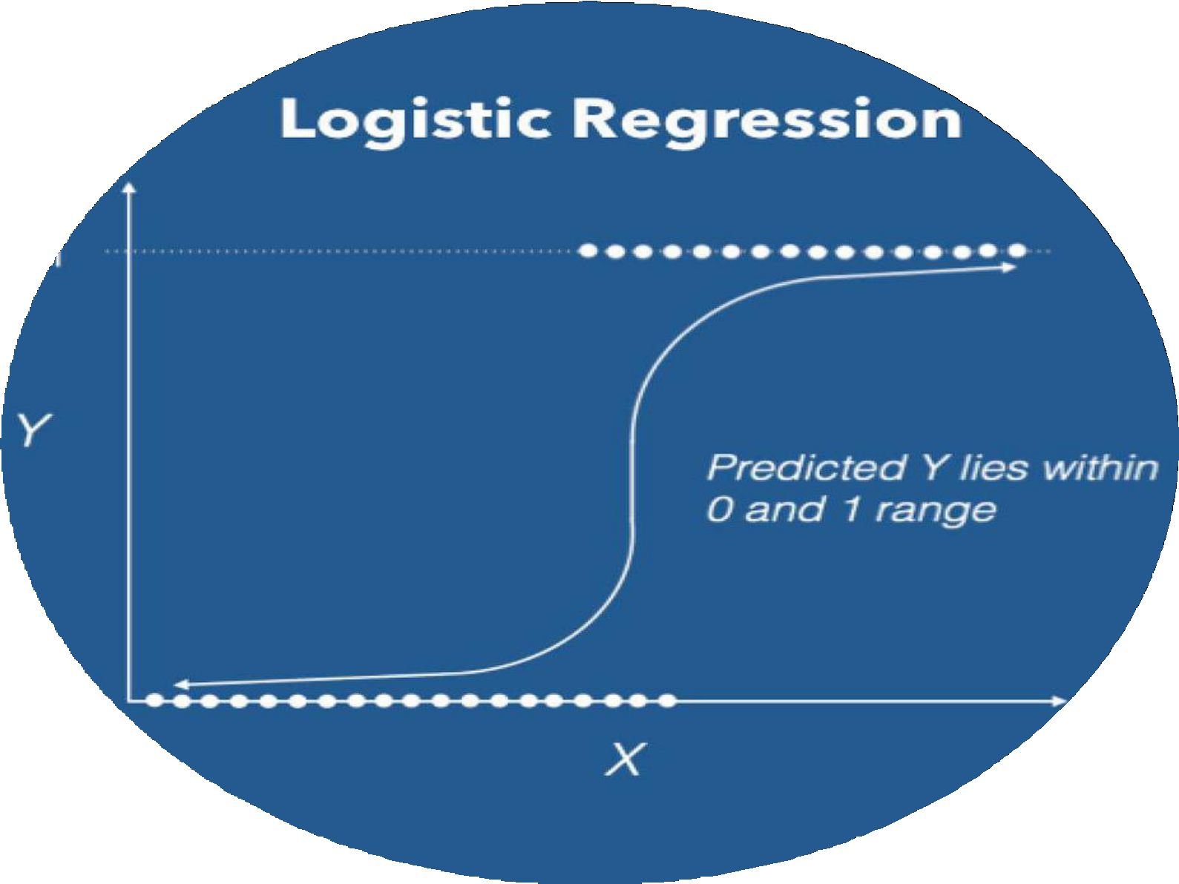

BUILDING A MODEL

Slide 16

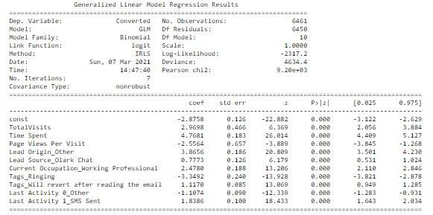
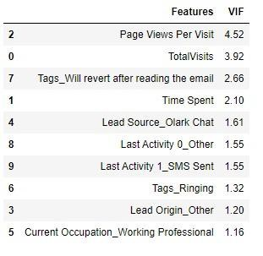
Final Model
Final VIF check

Slide 17

Model building along with feature selection (RFE ) and VIF check for multicollinearity.
After the removal of unnecessary variables, further modelling is conducted by taking 15 variables as an output. Irrelevant features may affect the model without getting the actual output in the end.
Features with high P- Values (0.05+) and VIF (more than 5) were removed eventually by building the model again.
Lastly, the model with 10 features and low P and VIF values are good to go for further predictions.

Slide 18

MATRIX SCORE TEST

Slide 19

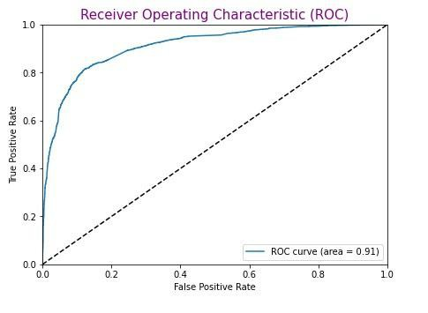
ROC CURVE
A ROC curve demonstrates several things:
It shows the tradeoff between sensitivity and specificity (any increase in sensitivity will be accompanied by a decrease in specificity).
The closer the curve follows the left-hand border and then the top border of the ROC space, the more accurate the test.
The closer the curve comes to the 45-degree diagonal of the ROC space, the less accurate the test.
As per the graph, the ROC curve covered almost 91% of the total area.

Slide 20

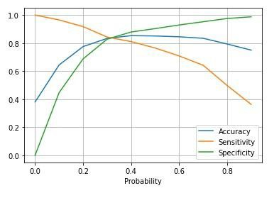

OPTIMAL THRESHOLD
The values of accuracy, sensitivity, and specificity were used for finding out the optimal threshold.
From the curve, 0.3 is the optimum point to take as a cutoff probability.

Slide 21

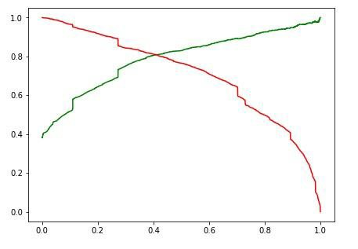
PRECISION - RECALL CURVE
Precision is a metric that quantifies the number of correct positive predictions and recall is as same as sensitivity used for quantifying the positive predictions by finding true positive and false negative.
Precision and recall are used for knowing the exact terminologies can be helpful as both of these pairs of metrics are often used in the industry.
The right side graph shows a glimpse of the jumpy curve for precision. Both curves meet at 0.4.

Slide 22
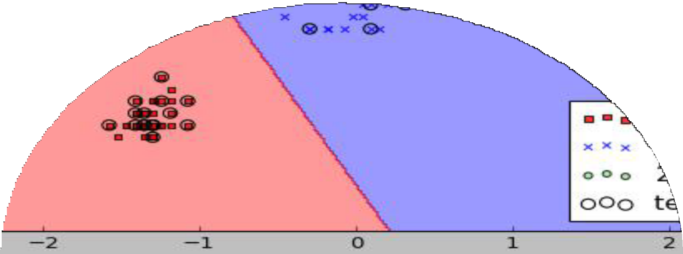
PREDICTION ON TEST DATA

Slide 23

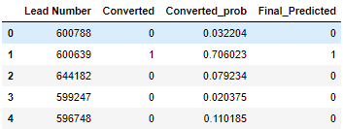
THESE ARE THE FOLLOWING VALUES AFTER DOING THE MODEL EVALUATION FOR TEST DATA
FINAL PREDICTION :

Slide 24



CONFUSION MATRIX:
PREDICTED ACTUAL
NOT CONVERTED
CONVERTED
NOT CONVERTED
1472 (TN)
195 (FP)
CONVERTED
218 (FN)
884 (TP)
Model Accuracy (Correctly predicted labels / Total no. of labels ): 0.850
Sensitivity (TP / TP + FN) : 0.802 Specificity (TN / TN + FP) : 0.883

Slide 25

RECOMMENDATIONS
Though the page per visit is high, the customer will be in a dilemma related to the course like comparing this course with others because of which conversion ratio is low.
As per the business aspect, working professionals have probable chances of getting converted.

Slide 26
Important features that contributed most towards the probability of a lead getting converted are :
Time Spent
Lead Origin_Other TotalVisits
Features that need to be focused more :
Last Activity 0_Other Page Views Per Visit Tags_Ringing

Slide 27
THANK YOU

